Slide 1
DECODING THE 2026
TAMIL NADU ASSEMBLY ELECTION
A Fact-Based Data Analysis for AtliQ Media
ANALYST
DATE
DATA SOURCE
Priyanka Singh
28 May 2026
Election Commission
of India
Power BI • ECI Data • 2021 vs 2026 Tamil Nadu Assembly Election Analysis

Slide 2
THE DATA BEHIND THE STORY
234
6
12
3
Assembly Constituencies
Regions Analyzed
Parties in 2026 Election
Key Story Dimensions
Three Key Stories Explored:
01
02
03
Vote Share Analysis
Geographical Seat Shift
Constituency Flip Analysis
Where did the votes go?
TVK debuted with 34.92% vote share.
How did seats shift across regions?
DMK lost 74 seats; TVK won 108.
How many constituencies changed hands?
90.6% of seats flipped winners.
Data Source: Election Commission of India | Comparison: 2021 vs 2026 Tamil Nadu Assembly Elections

Slide 3
STORY 1
WHERE DID
THE VOTES GO?
Vote Share Analysis • 2021 vs 2026 • Party-wise Breakdown

Slide 4
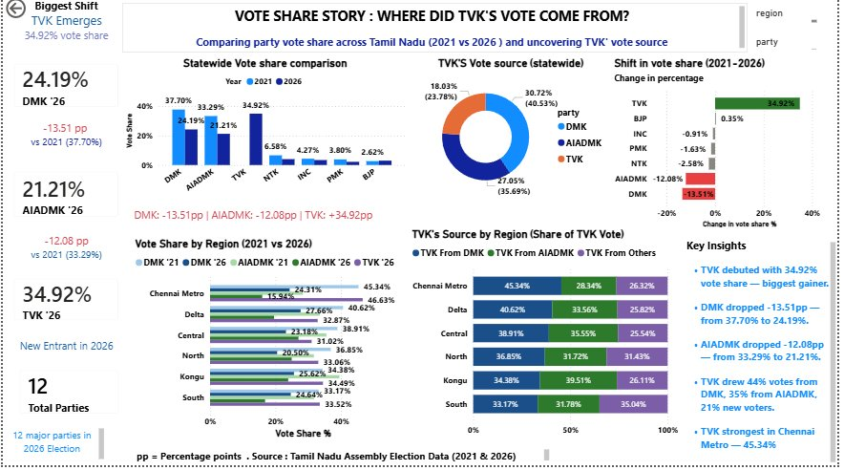
STORY 1: WHERE DID THE VOTES GO?
pp = Percentage Points • Source: Tamil Nadu Assembly Election Data (2021 & 2026) • TVK: New entrant 2026

Slide 5
VOTE SHARE — KEY TAKEAWAYS
34.92%
−13.51pp
−12.08pp
45.34%
TVK Debut Vote Share
DMK Vote Drop
AIADMK Vote Drop
TVK Chennai Metro
Biggest gainer — new entrant 2026
37.70% → 24.19%
33.29% → 21.21%
Strongest regional performance
TVK Emerges as Major Force
TVK debuted with 34.92% statewide, drawing 44% votes from DMK, 35% from AIADMK, and 21% new voters.
DMK Loses One-Third of Vote Base
DMK fell from 37.70% to 24.19% — a 13.51 percentage point decline across all six regions.
AIADMK Also Declines Sharply
AIADMK dropped from 33.29% to 21.21% — losing ground in every region, particularly Chennai Metro.
Chennai Metro: TVK's Stronghold
TVK achieved 45.34% in Chennai Metro, with gains from both DMK (28.34%) and AIADMK (26.32%) voters.

Slide 6
STORY 2
HOW DID SEATS
SHIFT ACROSS REGIONS?
Geographical Seat Analysis • Six Regions • DMK vs TVK Performance

Slide 7
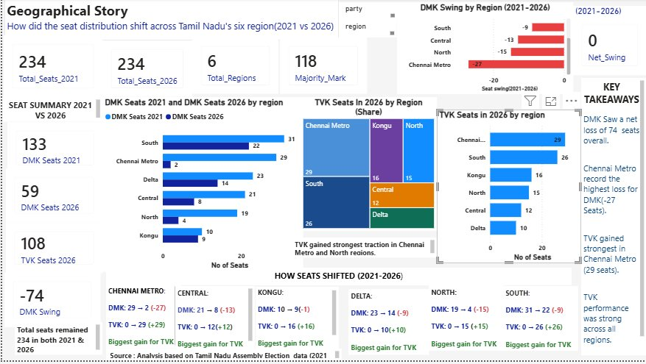
STORY 2: HOW DID SEATS SHIFT ACROSS REGIONS?
Source: Analysis based on Tamil Nadu Assembly Election Data (2021 & 2026) • Total Seats: 234 (both years)

Slide 8
GEOGRAPHICAL SHIFT — KEY TAKEAWAYS
−74
108
−27
29
DMK Seat Loss
TVK Seats (Debut)
Chennai Metro
TVK Chennai Metro
133 → 59 seats
Biggest debut win
Highest DMK loss region
Strongest TVK region
Region
DMK 2021
DMK 2026
TVK 2026
DMK Swing
Chennai Metro
29
2
29
-27
Central
21
8
12
-13
North
19
4
15
-15
South
22
31
26
-9
Kongu
10
9
16
-1
Delta
23
14
10
-9

Slide 9
STORY 3
HOW MANY CONSTITUENCIES
CHANGED HANDS?
Constituency Flip Analysis • Regional Flip Rates • Winner Patterns

Slide 10
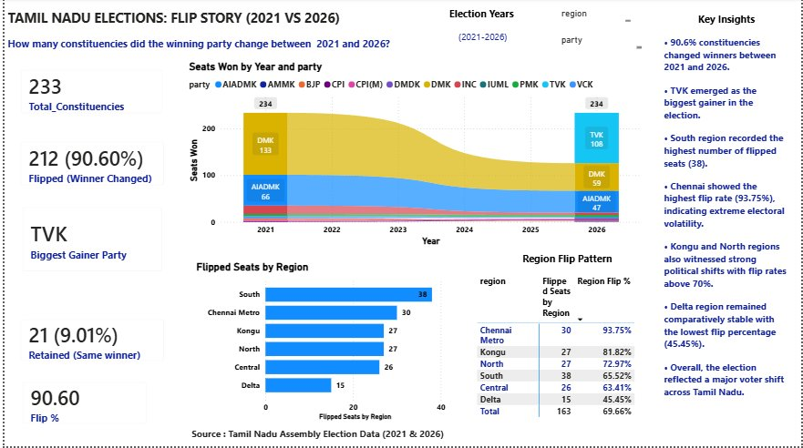
STORY 3: HOW MANY CONSTITUENCIES CHANGED HANDS?
Source: Tamil Nadu Assembly Election Data (2021 & 2026) • Total Constituencies: 233 (one N/A excluded)

Slide 11
FLIP ANALYSIS — KEY TAKEAWAYS
90.60%
Region
Flipped Seats
Flip Rate
Chennai Metro
30/32
93.75%
Kongu
27/33
81.82%
Constituencies Changed
Winners (212 of 233)
North
27/37
72.97%
South
38/58
65.52%
Central
26/41
63.41%
TVK
Delta
15/33
45.45%
Biggest Gaining Party
Chennai Metro — Most Volatile
93.75% flip rate — extreme political swing. DMK lost 27 seats here.
Delta Region — Most Stable
Lowest flip rate at 45.45% — comparatively stable despite overall shifts.
Only 21 Constituencies Retained
Just 9.01% constituencies retained the same winning party across both elections.

Slide 12
THE BIG PICTURE
2026 Tamil Nadu Assembly Election — Complete Summary
01
Major Political Realignment
2026 recorded the biggest political shift in recent Tamil Nadu history — vote shares, seats, and constituencies all transformed simultaneously.
02
TVK — A Historic Debut
TVK won 108 seats and 34.92% vote share in its very first election — an unprecedented result for a new political party.
03
DMK & AIADMK Parallel Decline
Both established parties lost heavily across all six regions — DMK by 74 seats and AIADMK significant vote share, marking a historic parallel decline.
Vote share, seats, and constituencies all shifted simultaneously — a complete political transformation of Tamil Nadu

Slide 13
THANK YOU
for your attention
ANALYST
TOOL
DATA
SOURCE
CHALLENGE
Priyanka Singh
Power BI
Election Commission
of India (ECI)
Codebasics Resume
Project Challenge
Note: Analysis is based only on publicly available ECI election result data.
No exit polls, surveys, or demographic data were used.

